Slide 1
The Covid19's Effects on Tourism in Turkey
Ersan Şen 17030411002
Ali Rahmi Atalay 17030411017

Slide 2
COVID19 and Tourism: When Starting…
Despite the negative impact of the pandemic in many areas, the economic damage is too great to ignore. In this sense, the tourism sector, which is one of the most important sources of income and foreign exchange for Turkey, is literally experiencing a collapse. In this presentation, we will be addressing the effects of the COVID19 pandemic on tourism in Turkey.
Using statistical data to better see the effects of the pandemic gives us a more understandable method. In this sense, we will be analyzing some of the data we have obtained and visualized.

Slide 3
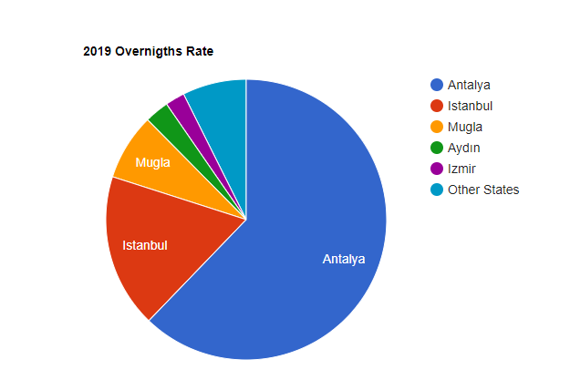
How Was The Last Year Before The Pandemic?
In 2019, approximately 45 million tourists visited Turkey and left close to $ 35 billion in foreign currency. In the chart next door, we see some provinces visited and stayed by tourists in 2019. From here we can also understand that tourism is a major source of income for many provinces.

Slide 4
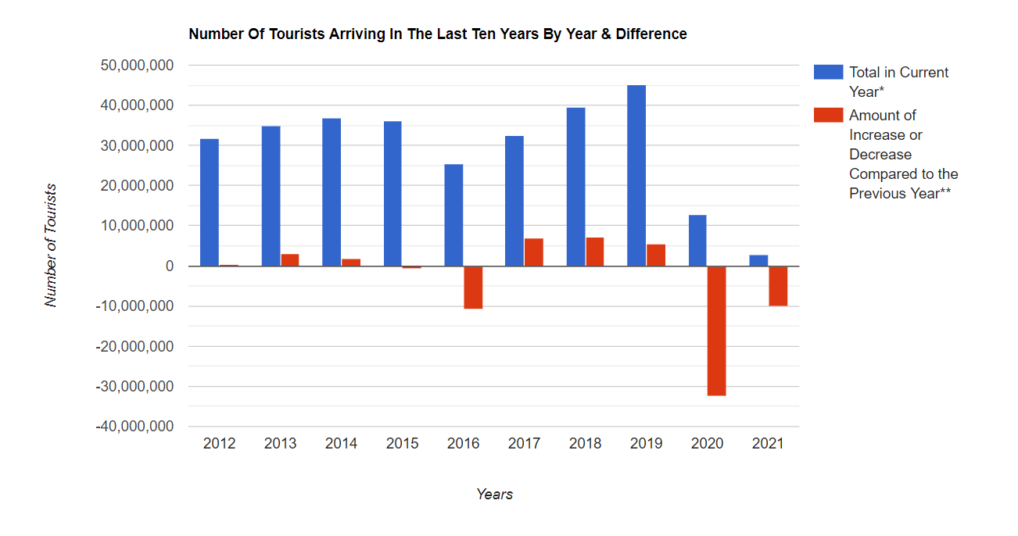
Tourist Distribution by Year Before and After the Pandemic
If we look at the distribution of tourists over the last 10 years, we see an increase in the number of tourists until 2020, except 2016 because of special cases.
Due to the health problems caused by the pandemic, it caused a serious decline in 2020 and beyond.

Slide 5
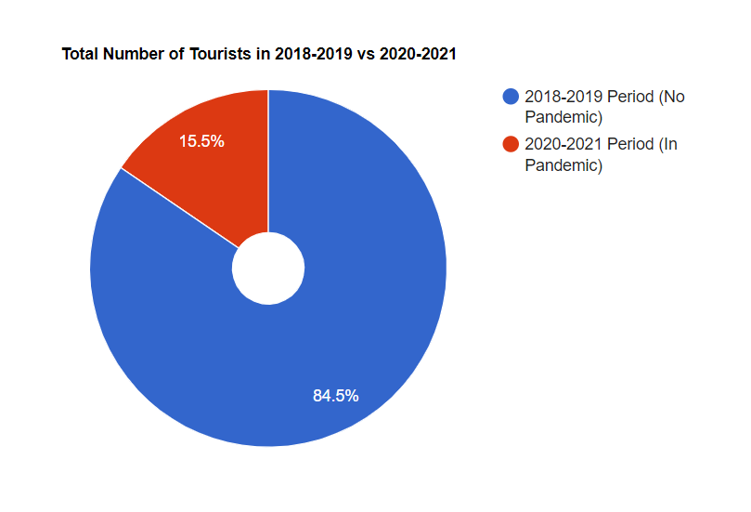
Comparison of 2018-2019 and 2020-2021 Periods
When we look at the total number of tourists in the nearest 2 years before and after the pandemic, we can see how big the difference is.
In the 2018-2019 period, approximately 85 million tourists visited our country, but in the 2020-2021 period, this number remained approximately only 15 and a half million.

Slide 6
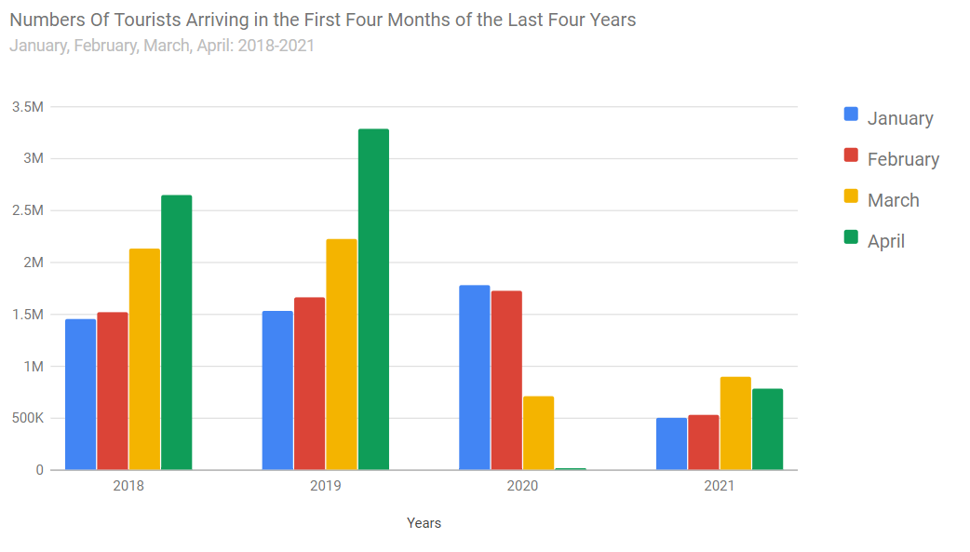
Number Of Tourists In The First Quarters Of The Last 4 Years
Since the 2021 tourist season has not yet started, comparing the numbers of the past 4 months with the first 4 months of the past 4 years will contribute to our ability to follow the developments more accurately.
We can see that the sharp decline in April 2020 increases with measures taken in the same period next year.

Slide 7
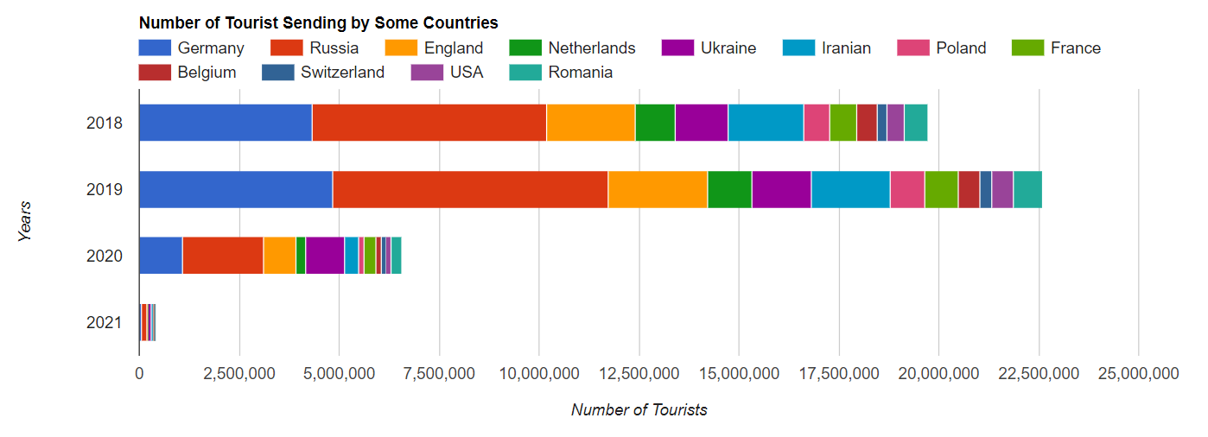
Some Countries That Have Sent The Most Tourists To Turkey In The Last 4 Years
Health problems, restrictions and travel prohibitions caused by the pandemic have a serious negative impact on many countries including Germany and Russia which send the most tourists to Turkey. This situation is damaging our country's tourism sector.

Slide 8
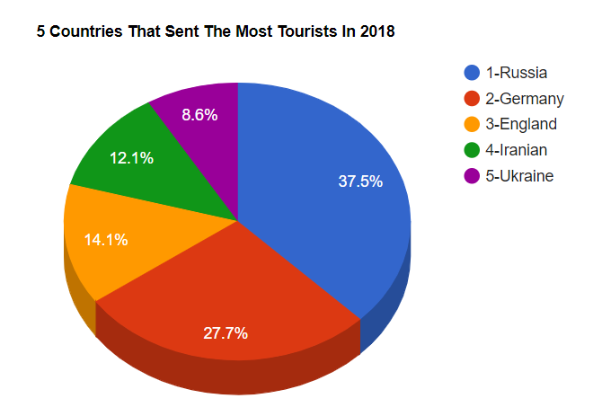
5 Countries That Visited Turkey the Most in…
2018
In 2018 (before the epidemic), approximately 39 and a half million tourists visited Turkey in total. In the chart side, we can see the 5 countries that send the most tourists in this year. Also, there were no restrictions and approximately $ 29 and a half billion foreign exchange revenue was acquired.

Slide 9
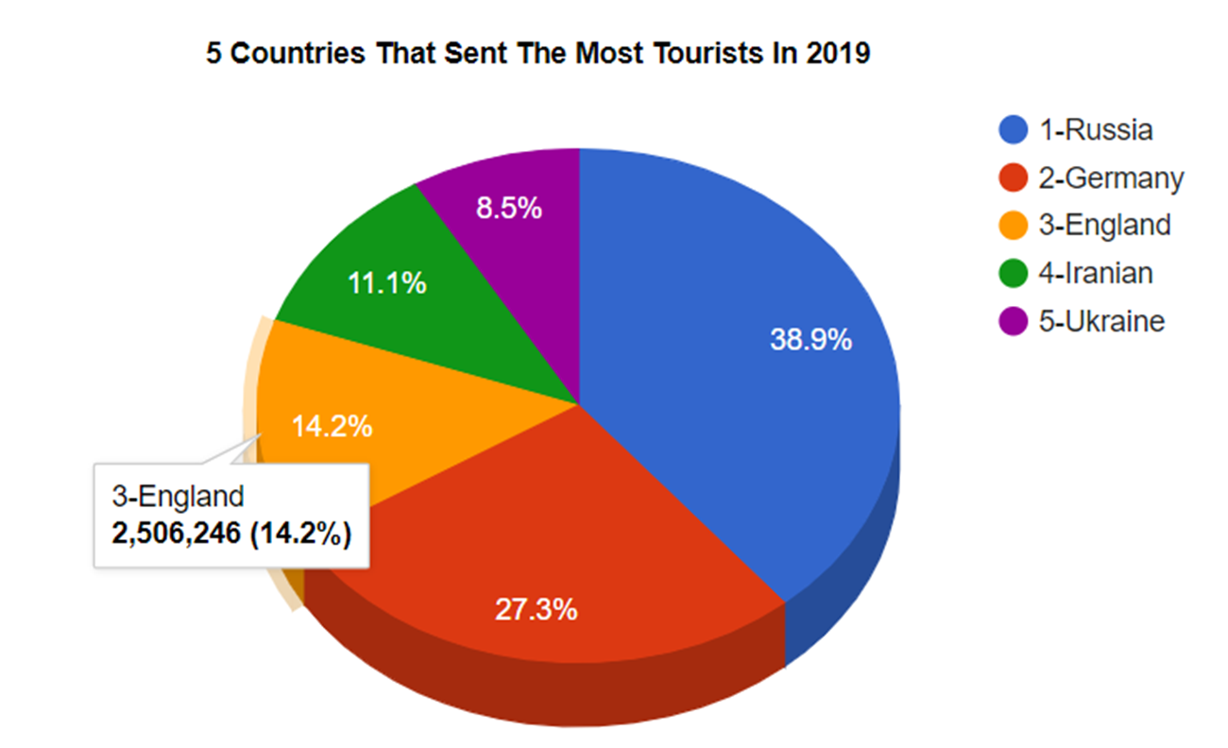
in 2019 (Before the epidemic)…
In 2019, approximately 45 million tourists visited Turkey in total. In the chart side, we can see the 5 countries that send the most tourists in this year. Also, there were no restrictions and approximately $ 34 and a half billion foreign exchange revenue was acquired.

Slide 10
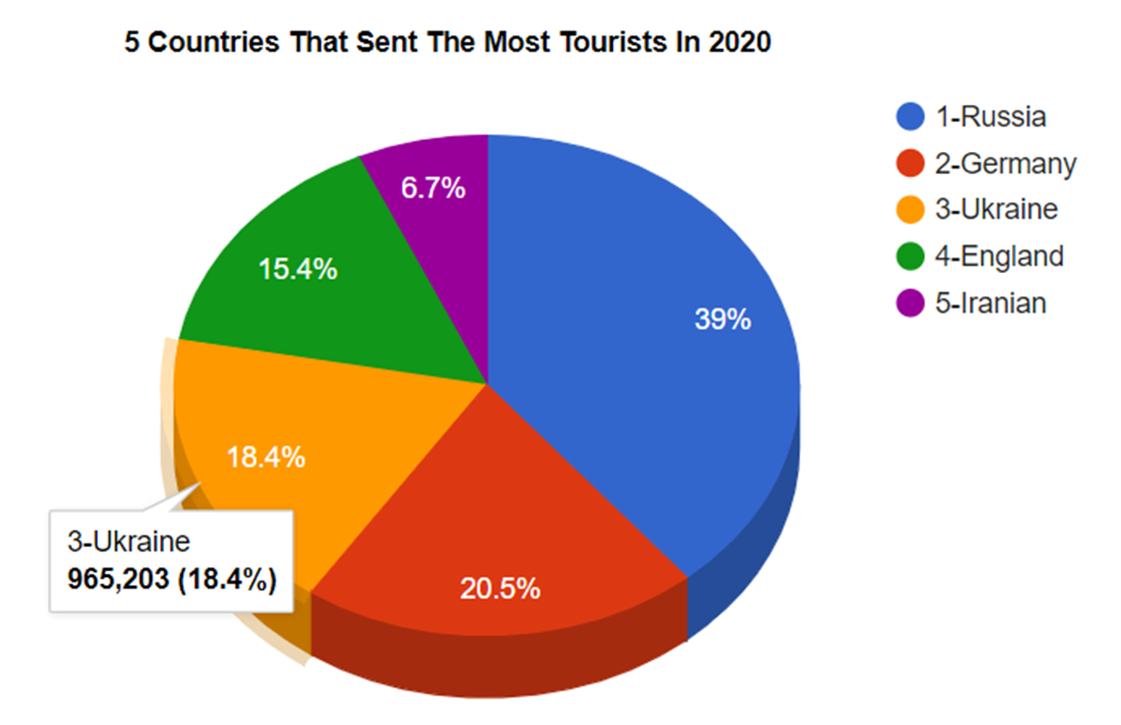
in 2020 (Epidemic has started)…
In 2020, approximately 13 million tourists visited Turkey in total. In the chart side, we can see the 5 countries that send the most tourists in this year. Also, there were no restrictions and approximately $ 12 billion foreign exchange revenue was acquired.

Slide 11
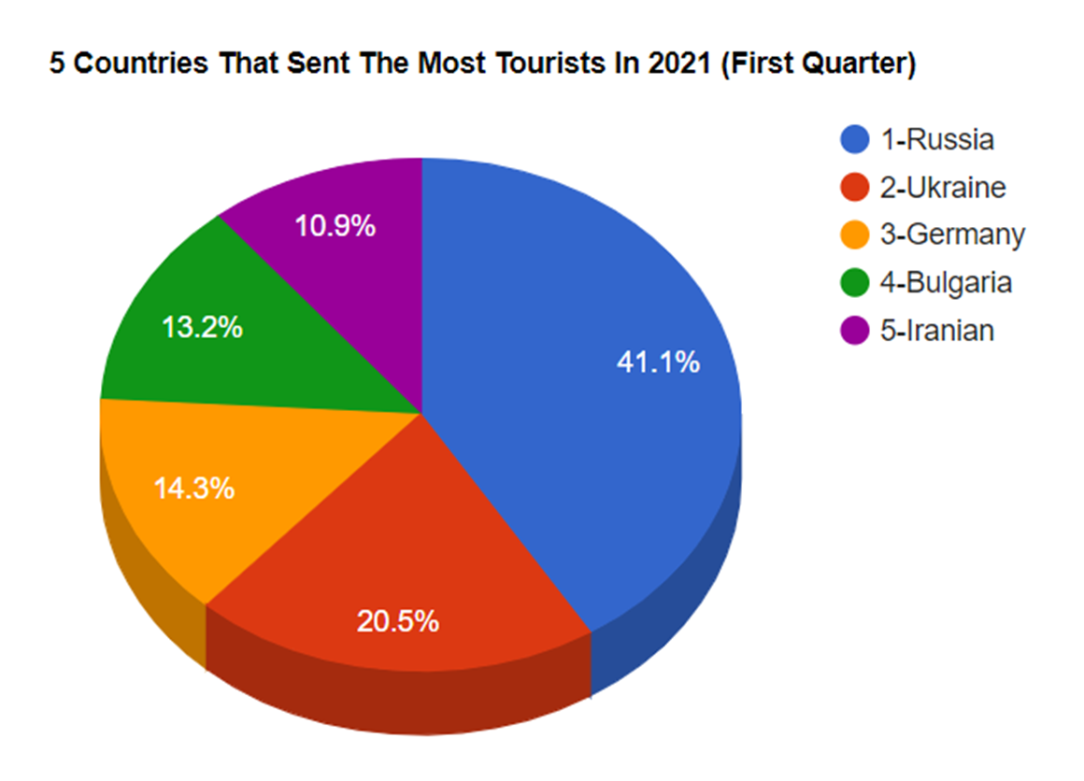
in 2021 (Epidemic is still continuing)
Since we have just completed the first quarter of 2021, the total number of tourists for the first 4 months is approximately 2.8 million. Revenue acquired until today remained at approximately $ 2 and a half billion. Therefore, we can say that revenue has experienced one of its lowest periods.

Slide 12
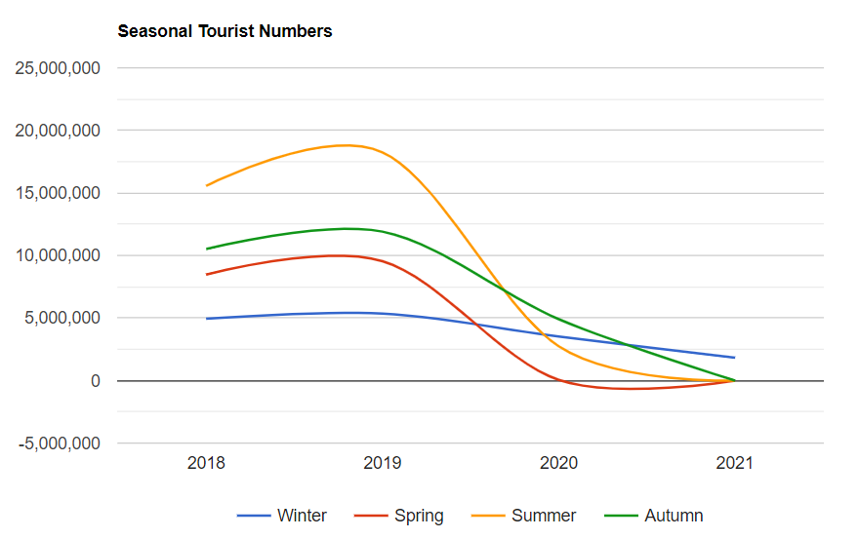
Change in Seasonal Tourist Numbers
By looking at the chart, we can easily say that the period received the most tourists is usually summer. When we look seasonally before and after the epidemic, we see that there have been serious declines even including summer times. This clearly shows how much the epidemic negatively affects tourism.

Slide 13
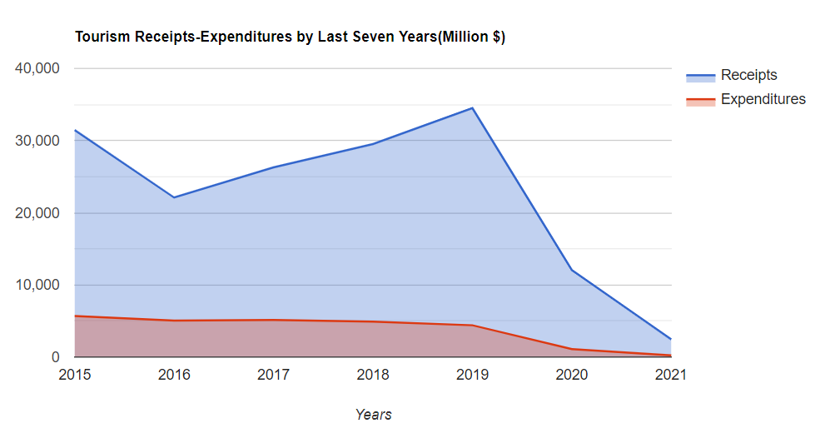
Total Tourism Receipts & Expenditures According to Last 7 Years
As we can see in the chart, with the decrease in the number of tourists, there were also critical decreases in the amount of income. Although expenses did not decrease as much as income rates, however they were directly affected by the pandemic.

Slide 14
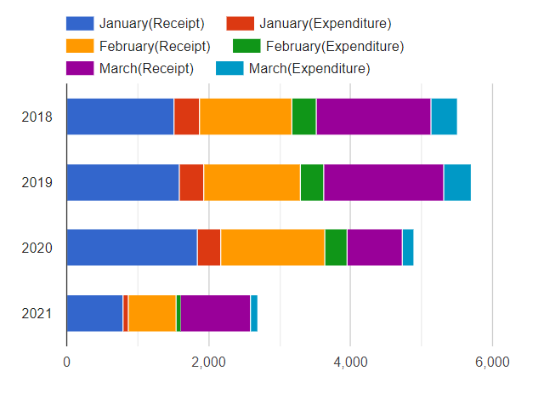
Total Tourism Receipts & Expenditures In The First Quarters Of The Last 4 Years
Since we are just early in 2021, comparing the first quarter data of 2021 and the first quarter data of the last 3 years will help us get more concrete ideas.
In here, we see that income and expense ratios are generally falling in the same direction.

Slide 15
Number of Tourism Agency & Change Rates
Looking at the chart, we see that the number of tourism agencies has increased despite the pandemic. Due to the fact that the effects of the pandemic in Turkey have not yet started in the first quarter of 2020, there were no indirect closures from the pandemic in enterprises. In addition, due to the first year of the pandemic, businesses with available resources have tried or suspended their activities for some time. Since we have not yet reached the data for 2021, we cannot compare it to 2020.
When we look at the rate of change in the number of agents in the current year compared to the amount of increase in the previous year, we usually see fluctuations, but we see that the rate of increase in 2020 has decreased compared to the previous year.

Slide 16
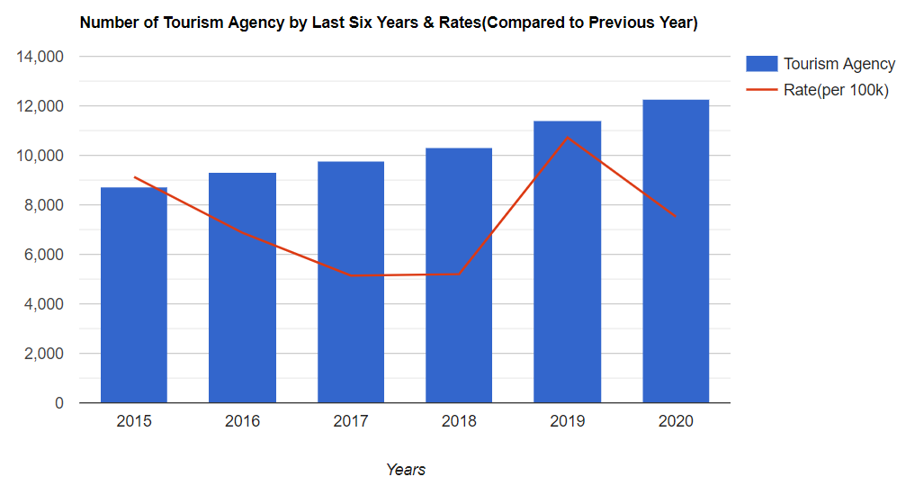
Number of Tourism Agency in Last 6 Years & Change Rates

Slide 17
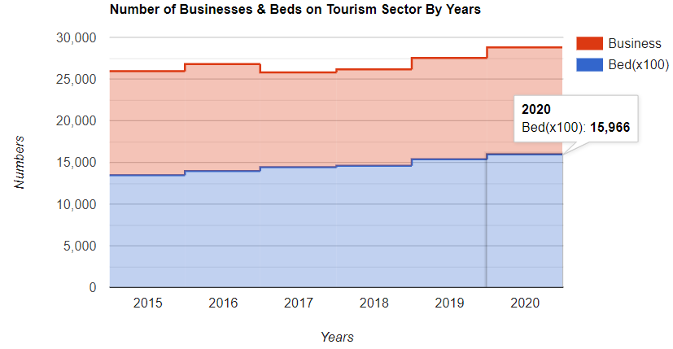
Number of Businesses and Beds in the Last 6 Years
At the dates when the data was last announced, we can see that the number of businesses has increased because we have not yet seen their impact as the pandemic has just begun. Accordingly, although there are fluctuations in the number of beds, we can say that it has increased in connection with the number of businesses.

Slide 18
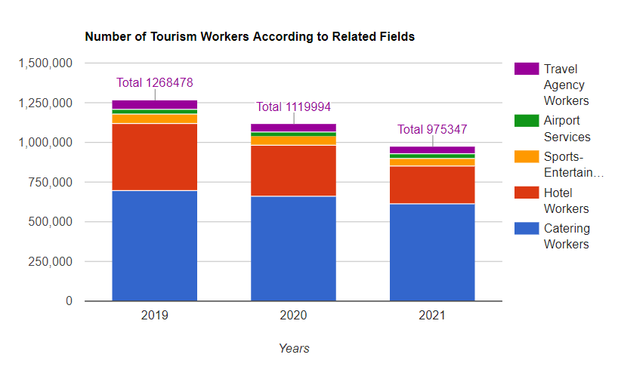
Number Of Workers In The Tourism Sector
In this chart, we can see the number of tourism employees in the last 3 years according to the areas in which they worked. As we can clearly see, there has been a serious decline in the number of workers due to the negative impact of epidemic on the tourism.
Although the number of businesses has increased, we can show situations as reasons for the decline in the number of workers such as some businesses removing workers without closing, reducing the number of workers because of the suspending their activities for a while.

Slide 19
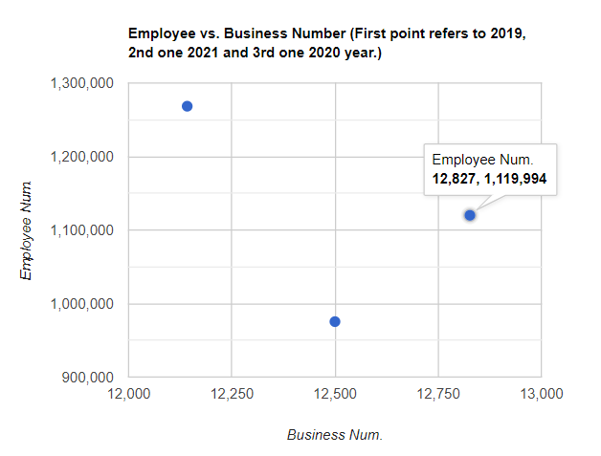
Relation Between Employee Number & Business Number
Finally, when we look at the relationship between the number of workers and businesses in the last 3 years, we see that there is a disproportionality in general. While the number of businesses may increase, the number of workers may decrease.
As there is no business number data for 2021, the estimated value has been taken.

Slide 20
References
Turkish Statistical Institute; Education, Culture, Sports and Tourism Statistics.
Web Site: https://data.tuik.gov.tr/Kategori/GetKategori?p=egitim-kultur-spor-ve-turizm-105&dil=1
Republic of Turkey Ministry of Culture and Tourism General Directorate of Investments and Enterprises
Web Site: https://yigm.ktb.gov.tr/TR-9851/turizm-istatistikleri.html
Association of Turkish Travel Agencies; Tourism Reports and Statistics
Web Site: https://www.tursab.org.tr/istatistikler/turizmin-ekonomideki-yeri#
Tourism Data Bank; Statistics & News
Web Site: https://www.turizmdatabank.com/
Tourism Diary: Tourism and Travel Newspaper; News
Web Site: https://www.turizmgunlugu.com/
Hotel Association of Turkey
Web Site: http://www.turob.com/tr

